Slide 1
Genotype-environment association (GEA)
How does the environment shape genetic variation?
GEA methods test for signals of adaptive divergence associated with environmental variation

Slide 2
Murray river rainbowfish
(Melanotaenia fluviatilis)
Generalist species
Some capacity for dispersal
Most southern rainbowfish
Less abundant in south
Steep climatic gradient
Local adaptation?
249 individuals, 17503 SNPs

Slide 3
WETQTEMP
HOTMTHMAX
ANNRAIN
COLDQRAIN
ANNVAR
PERENIALITY

Slide 5
Multivariate ordination
Two major types
Unconstrained
Constrained
Identifies axes that account for variation in the data e.g. PCA, CA
Combines unconstrained ordination with regression analysis, with the axes of variation being constrained to linear combinations of a set of predictor variables e.g. CCA, RDA

Slide 6
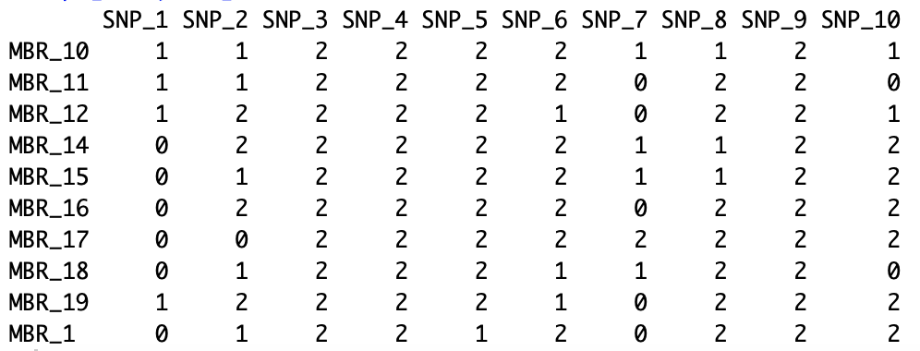
Redundancy analysis
Y ~ x
Genotypes ~ environmental variables
~

Slide 7
Partial redundancy analysis
Y ~ x + Condition(z)
Genotypes ~ environmental variables + Condition(space)
~
+ Condition(
)

Slide 8
Partial redundancy analysis
Y ~ x + Condition(z)
Genotypes ~ environmental variables + Condition(space)
~
+ Condition(XY)

